Slide 1
Bike Alert
Get Help For Mechanical Issues

Slide 2
Commuting By Bicycle
Save money
Help the environment
Get easy exercise
Don’t have to worry about parking
See new things
Save lots of money

Slide 3
Common Issues
Popped tube
Chain falls off
Broken spoke
Brakes too tight/too loose
Loose handlebars
Loose wheel

Slide 4
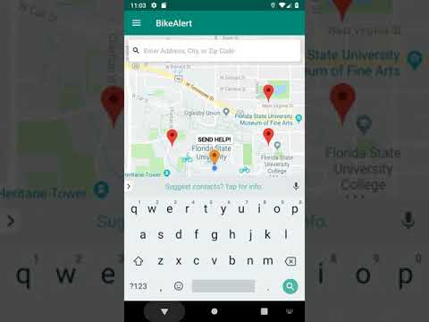
App Demo

Slide 5
Apps Like BikeAlert
AAA
Uber/Lyft
Strava

Slide 6
Citations
https://firebase.google.com/docs/android/setup
https://codelabs.developers.google.com/codelabs/realtime-asset-tracking/index.html?index=../../index#5
https://codinginflow.com/tutorials/android/navigation-drawer/part-3-fragments
https://developers.google.com/android/reference/com/google/firebase/firestore/GeoPoint
https://firebase.google.com/docs/firestore/query-data/get-data
https://firebase.google.com/docs/firestore/query-data/listen
https://firebase.google.com/docs/reference/android/com/google/firebase/firestore/Query
https://developer.android.com/studio/debug/am-video
https://stackoverflow.com/questions/40366717/firebase-for-android-how-can-i-loop-through-a-child-for-each-child-x-do-y
https://stackoverflow.com/questions/10111073/how-to-get-a-bitmap-from-a-drawable-defined-in-a-xml/10111203#10111203
https://developers.google.com/maps/documentation/android-sdk/start
https://developers.google.com/maps/documentation/android-sdk/map-with-marker

